Slide 1
4. Progress
Back to SCORE constructed

Slide 2
4. Progress
Back to SCORE constructed
Score
Functions
Search
Suggestion
Analysis & Visualization
Report
Details
School name
School type
Year
Score base
Location base
Combo charts
Correlational comparison
Filtering
Flexible ranking
General statistics
5. Future plans
Notes:
Here are some functions that are executed well in our website.

Slide 3
5. In developing

Slide 4
5. Future plans

Slide 5
5. Future plans
SCORE administrator
Score
Import
Update
Functions
Publish
Update annually
Notes:
We’re planning to add administrator page for our website so that the manager can adjust directly on database every year.

Slide 6
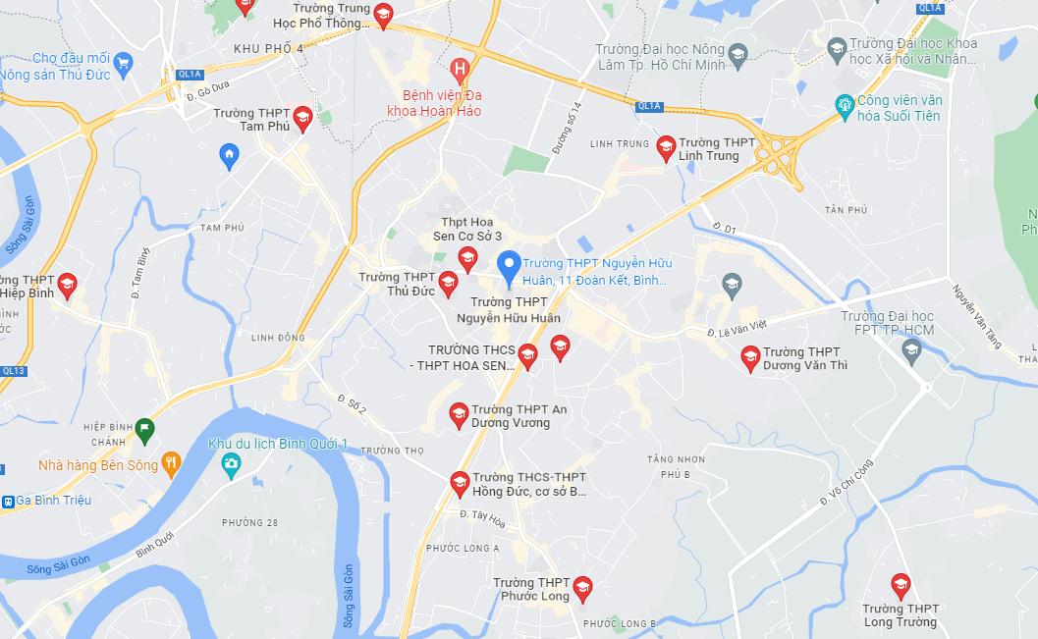
5. Future plans
Google maps API
Nearby Schools
Notes:
We expect to intergrate Google maps into website so as to give more details about location and support user decision.

Slide 9
https://score-official.rf.gd/

